Slide 1

Project Report: AI Resume Matcher & Candidate Ranking System
This is our project. Create a detailed project report for this project for the team of 5.
Team Size: 5 MembersDate: Friday, July 18, 2025

Slide 2
1. Project Overview
The project aims to develop an AI-driven Resume Matcher and Candidate Ranking System using Streamlit. This tool enables HR teams and recruiters to upload multiple resumes and a job description, and automatically match and rank candidates based on resume-job relevance using natural language processing and machine learning[1]. The system streamlines recruitment, reducing manual effort and bias by providing a data-driven candidate shortlist.
2. Project Objectives
Automate resume parsing and information extraction from PDF/DOCX files.
Compare candidate profiles with job descriptions using AI-driven similarity scoring.
Rank and filter candidates based on match percentage.
Provide a user-friendly interface for uploading files and viewing results.
Allow resume download for top-matched candidates.

Slide 3
3. Team Composition and Roles
Krish Tare
Management, Teamwork, Leadership, basic Python, Excel; oversees timeline, coordinates team[2]
Nayan Pandey
Python, scikit-learn, data analysis, model building, integration of AI/ML modules[3]
Abhishek Gupta
Streamlit, HTML/CSS, basic JS, UI/UX, ensures intuitive user flow[4]
Khizar Saifee
Resume parsing QA, test case creation, assist with data extraction functions
Arshad Shaikh
Writes documentation, manages requirements, supports deployment and maintenance

Slide 4
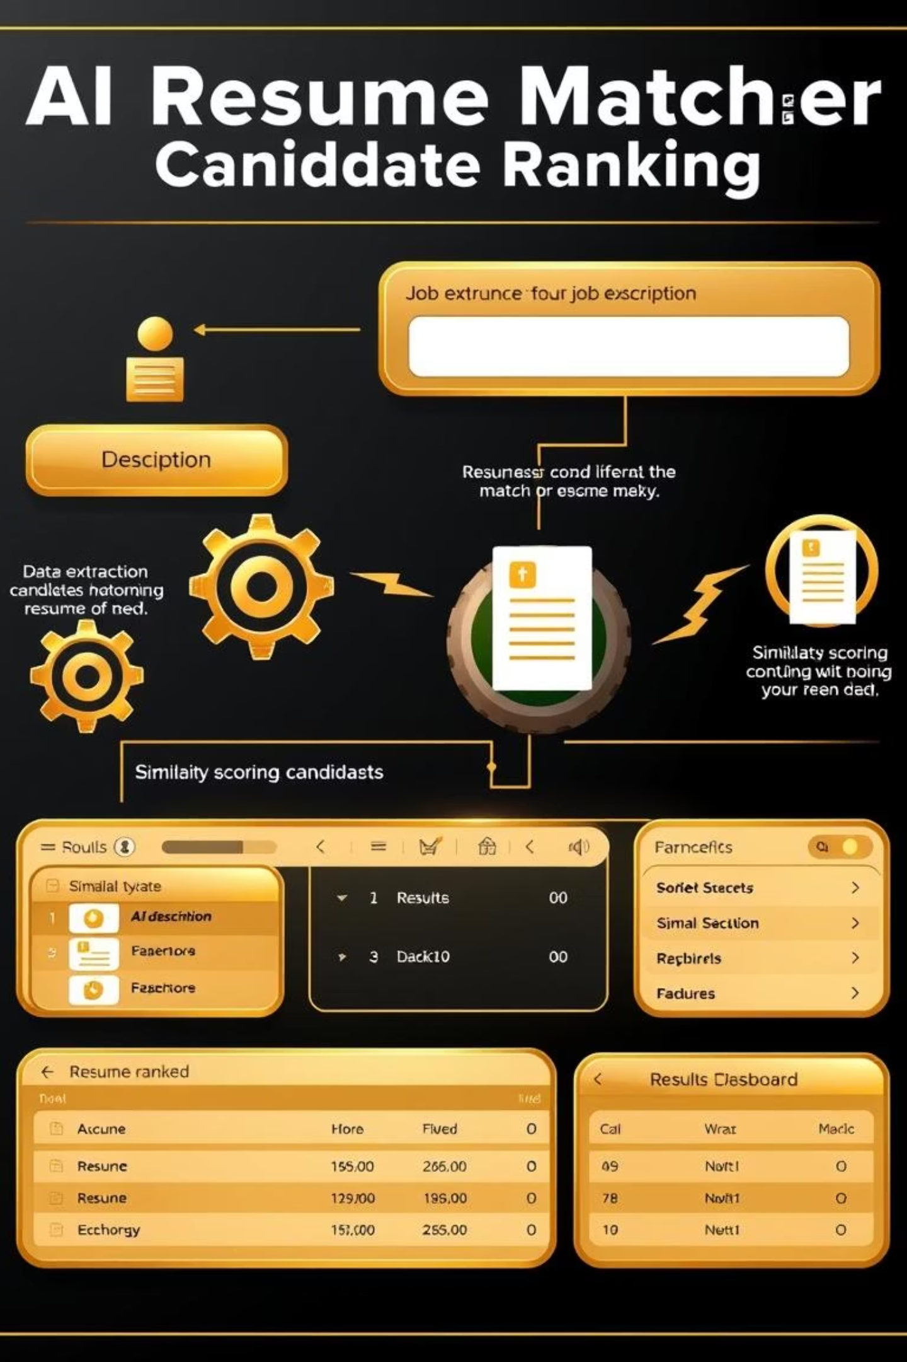
4. System Architecture
+-------------------------------+| User Interface (Streamlit) |+-------+------------+----------+| | |+-----------v-+ +----v---------+| File Reader | | Job Description Input |+----------+-------+ +----------+------------+| |+----------v---------------------v--+| Resume Data Extraction (NLP) |+----------+------------------------+| Extracted Data+----------v------------------------+| Similarity Scoring (AI/ML) |+----------+------------------------+|+----------v---------+|Ranking & Filtering |+----------+---------+|+----------v---------+|Results Visualization|+--------------------+

Slide 5





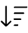


5. Technology Stack
Programming Language: Python 3.x
Web Framework: Streamlit
Key Libraries:
PyPDF2, docx2txt (file reading)
pandas, numpy (data handling)
scikit-learn (vectorization, similarity scoring)
spaCy (NLP, entity extraction)
matplotlib (visualization, optional)[5]
Deployment: Local, Streamlit Cloud, or internal server
6. Project Features
Resume Upload
Job Description Input
Automated Information Extraction
Batch upload of PDF/DOCX resumes[1].
Text area for custom job descriptions.
Name, Email, Phone, Skills, Education, Experience
AI-powered Matching
Ranking and Filtering
Candidate Insights
Calculate similarity between resumes and JD.
Sort and display candidates by relevance score.
Expandable panels for candidate details and download buttons.
Customizable threshold for minimum match[1].
Result Export
Download matched resumes.

Slide 6




7. Implementation Details
Resume Parsing
JD Matching
Utilizes PyPDF2 and docx2txt to extract raw text from resumes[1][5]. spaCy analyzes the text to identify structured information.
scikit-learn vectorizes the text (possibly TF-IDF or CountVectorizer), then computes a similarity score (e.g., cosine similarity) between the resume data and job description[1][5].
Frontend Workflow
Configuration
Built with Streamlit, providing drag-and-drop file upload, threshold slider, and results dashboard[1].
All required dependencies are listed in the requirements.txt file[5].

Slide 7
8. Project Timeline (Sample/Indicative)
Requirement Analysis
1 week
Functional/technical spec, user flows
Initial Setup & Planning
1 week
Repo, environment, task breakdown
Resume Parsing Module
2 weeks
Working text extraction & NLP scripts
JD Matching Module
1 week
Similarity scoring prototype
Frontend Development
1 week
Streamlit interface
Integration & Backend
2 weeks
End-to-end system
Testing & QA
1 week
Bug fixes, functional/performance QA
Documentation & Deployment
1 week
User manual, deployment on Streamlit
Buffer/Misc
1 week

Slide 8
9. Testing Plan
Upload mixed-format resumes (PDF/DOCX).
Test with different job descriptions.
Validate extracted information for accuracy.
Check ranking consistency and download functionality.
Edge cases: corrupted files, missing fields.
10. Challenges & Risk Mitigation
File format inconsistencies
Resume template diversity
Extensive input validation and error handling in file parsing.
Use robust NLP models for flexible entity extraction.
Performance
Data privacy
Employ async processing & optimize matching for larger datasets.
Do not store resume data after processing; advise users on secure handling.
11. References to Team Experience
The team brings a range of competencies:
Data science, Python programming, AI/ML, web/app development, and presentation skills[2][3][4].
Prior experience in dashboarding, prediction models, and AI assistant tools ensures readiness for both back-end and UX/UI tasks.
12. Future Enhancement Ideas
Support for additional file types (e.g., LinkedIn exports).
Advanced analytics: heatmaps, candidate benchmarking.
Automated recommendation feedback to applicants.
This structured approach and division of responsibilities will empower the team to deliver a robust, scalable solution that meets modern recruitment needs.

